Slide 1

Launching the Nigerian Off Grid Energy Revolution: Challenges & Opportunities
TechPoint Inspired , June 2019
Together with

Slide 2
What are the challenges?

Slide 3
Nigeria lags behind peers in terms of installed generation capacity...
Nigeria's installed capacity ranks worst and is 29GW less than the MINT Avg....
... it also ranks worst and is 27GW less when compared to N-11 peer Avg.
Ranking
17
18
23
72
13
14
17
18
23
32
34
36
46
57
72
GW
GW
43 GW is
MINT Avg
41 GW is
N-11 Avg.
Mexico
Turkey
Indonesia
Nigeria
South Korea
Iran
Mexico
Turkey
Indonesia
Egypt
Vietnam
Pakistan
Phillipines
Bangladesh
Nigeria
Source: Global power production rankings, accessed on www.cia.gov,
USAID Power Africa report 2017.

Slide 4
…on top of this, ~80% of Nigeria’s installed generation capacity is lost by the time it reaches the consumer
MW
13,700
14,000
Installed capacity losses are primarily driven by:
  Aging equipment
  Maintenance systems and culture
  Insufficient funding
  Spinning reserve
Losses are primarily driven by:
  Aging equipment, and poor maintenance
  Inadequate/Aged transmission networks (330Kv, 132Kv, 33Kv and 11Kv lines)
  Insufficient funding
  Transmission losses
9,000
Available capacity losses are mainly due to:
  Insufficient gas supply
  Inadequate infrastructure
  Vandalism
  Line constraints due to inadequate transmission infrastructure
<7,500
6,000
4,500
3,600
3,100
3,000
0
Genco
Installed capacity
Installed capacity losses
Available capacity
Generation efficiency Losses
Transmitted to TCN
Transmission losses
Supplied to Discos
Distribution losses
Distributed to final consumers
Source: BMI Nigeria Power Report Q1 2016.
A.F Mercanos NESI Challenges and Way forward report 2019

Slide 5
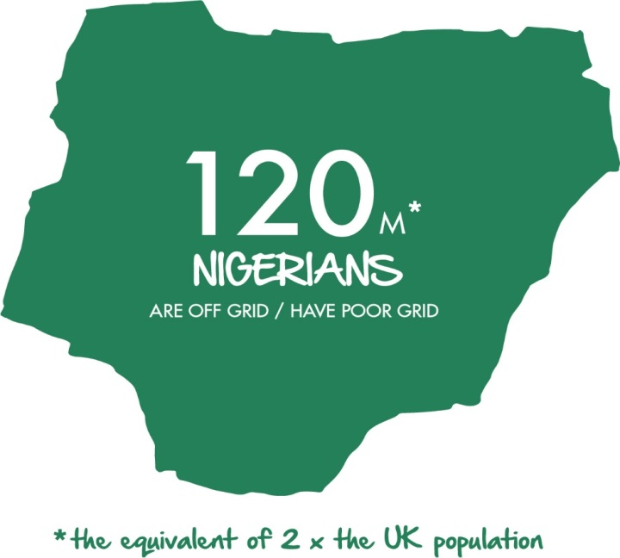
The result is that approximately 70% of Nigerian households are either totally off-grid or have a ‘bad grid’ connection with less than 4 hours of electricity per day
Number of HH in Nigeria, By Connectivity (2015)
millions,
25%
100%
9
37
37%
14
38%
We define ‘bad-grid’
as <4 hours per day of electricity (increasing
the band to <6 hours increases ‘bad grid’ materially)
14
Off-grid
Off-grid
Bad-grid
(<4 hours)
On-grid
Total
Source: Dalberg analysis, 2015

Slide 6




The energy gap in Nigeria is the foundation for so many of the country’s economic and social development problems
187
out of 190
WHO World Health Systems Report,
2017
115th
out of 140
WEF
Competitiveness Index, 2018
145
out of 149
Legatum Prosperity Index 2018
104th
out of 149
Legatum Prosperity Index, 2018
123rd
out of 149
Legatum Prosperity Index, 2018
187
out of 190
Global Food
Security Index,
2018

Slide 7
What is the opportunity?

Slide 8

The significant energy access gap in Nigeria means the opportunities to address the gap are also considerable
Challenges
Opportunities
~30GW to 175GW
Size of energy gap which would cost
$40-200 billion to address
~$20 billion
Amount Nigerians already spend on alternative energy solutions – 10x the grid;
70% of households & SME’s
Either off grid or bad grid (<4 hrs per day);
~$10 billion
Immediate investment opportunity in minigrids;
120 million people affected
Only India has a larger off grid/ bad grid population;
>10 million SHS units
Estimated market size for Nigeria;
~60 million generators
Diesel/petrol solutions fill the gap, emitting 5-7 million MT of CO2 annually;
High willingness to pay
3.5x India $ 2x East Africa;

Slide 9
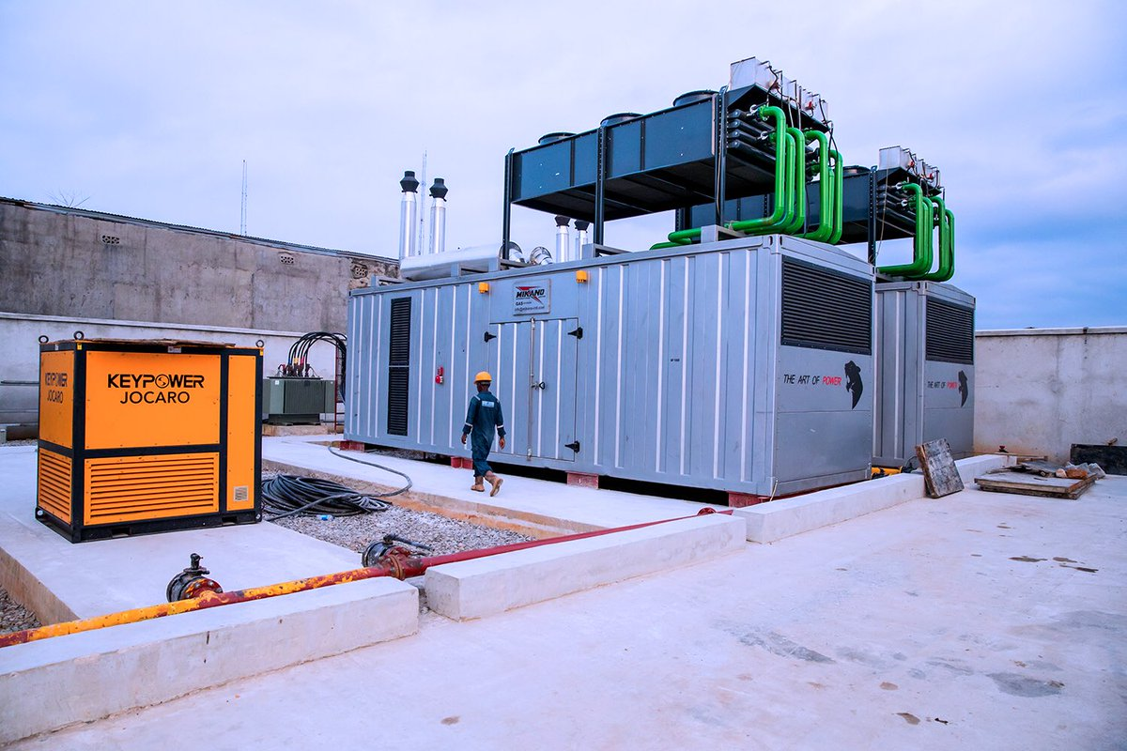
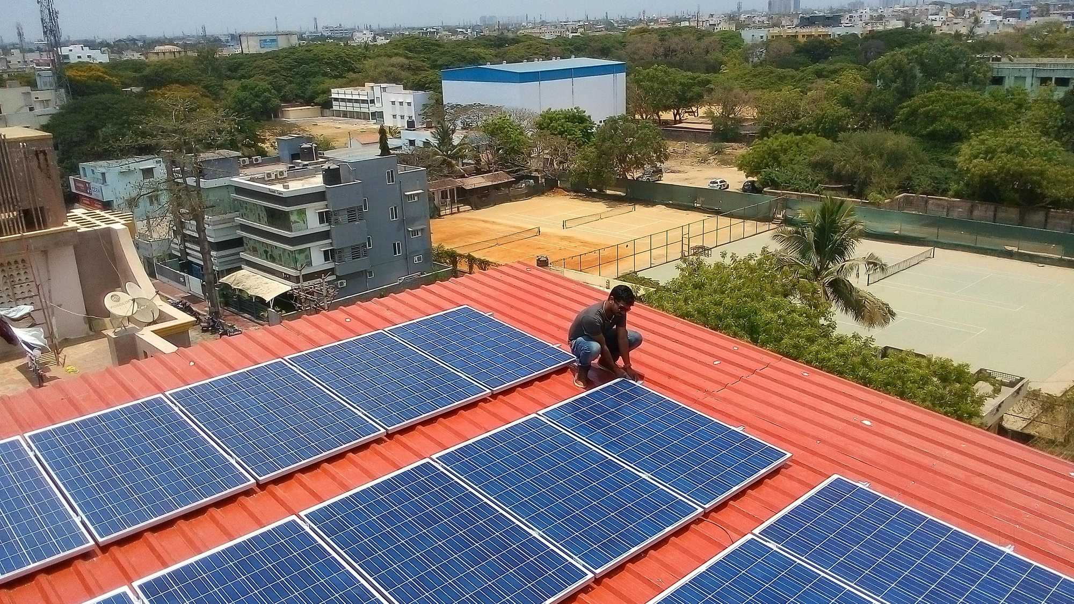
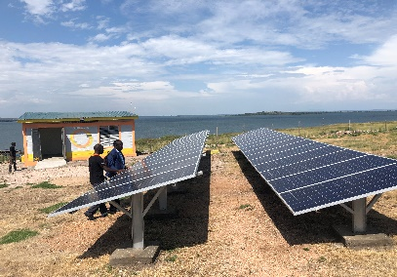
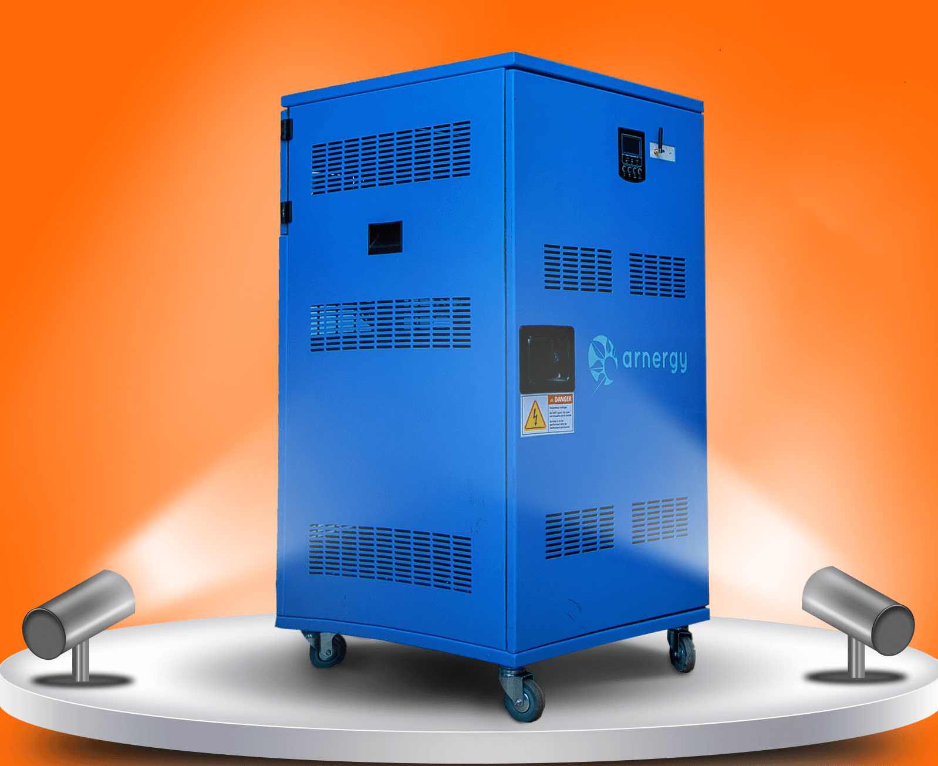
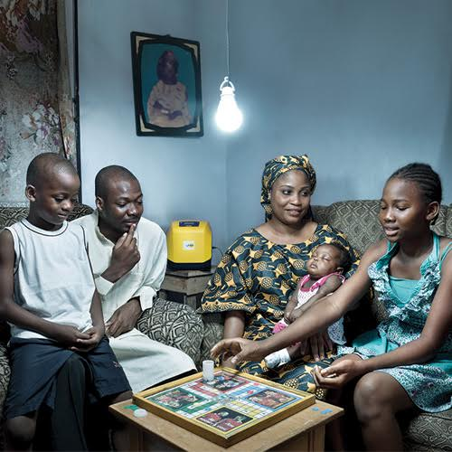


















Rising private sector interest, increased government support and improved regulation make off grid energy businesses attractive across multiple existing and emerging segments
Independent Power Producers
Commercial & Industrial (C&I)
Mini Grids
Solar Energy Systems
Solar Home Systems (SHS)
Primarily driven by <10MW plants, with some in 10-25MW range; primarily gas
Ranges from 50KW bank branches to 5MW embedded power for factories; primarily gas & solar
Electricity demand in localized area w/ generation ranging from 50kW-1MW; primarily solar, some gas & hydro; off grid & ‘undergrid’
Stand alone solar systems with capacity >1KW for large households & SMEs
Demand led by Pay As You Go solar home system segment ranging from 10W to 150W systems
Key Features
Key Players

Slide 10




























There is an active and fast growing off grid energy ecosystem to tap in to
NOT EXHAUSTIVE
Donors
Impact Investors
Entrepreneurs
Power Africa Nigeria Power Sector Program II (2018 – 2023) implemented by Deloitte
GIZ Nigeria Energy Support program (€33m) (2017 – 2020) - technical assistance and capital grants for procurement of electrical equipment;
The World Bank: $350m program for result-based grants for the off-grid sector which is awaiting Nigerian Senate approval.
African Development Bank: Committed another $200 million to the World Bank program
Sunref program (€74m) lending program in conjunction with EU, disbursed through local commercial banks
Shell Foundation: operating through the Nigeria Off-Grid Energy Market Acceleration Program (NOMAP), the Energy Company of the Future initiative, and grants to companies
DFID Solar Nigeria grant program (£11m)
(2014 - 2020);
Other USG Power Africa partners including USADF (operating in partnership with All On), and USTDA;
The Electrification Financing Initiative (ElectriFI) funded by the European Commission and managed by the Association of European Development Finance Institutions (EDFI) - €120m global facility and €30m Nigerian focused facilities;
Breakthrough Energy Ventures (Bill Gates, Richard Branson);
Acumen; a non-profit impact investment fund focused on ;ow-income communities in developing countries across Sub-Saharan Africa, South Asia, Latin America
SunFunder; a solar energy finance business with a mission to provide debt financing for solar assets in emerging economies
Persistent Energy Capital; a principal investment firm investing in, incubates, and advises businesses providing distributed renewable energy to off-grid customers.

Slide 11
What are we doing?

Slide 12


All On (funded by Shell) has a dynamic approach that combines investment and market development activities with strategic partners to unlock access to energy in Nigeria
Global and
local partners
  Impact Investing
  Supporting and investing debt & equity directly in
  existing energy firms to help grow and achieve scale
$
  Enabling Finance
  Supporting & investing in enabling finance facilities that leverage additional capital for offgrid companies
IMPACT
  Enabling Environment
  Facilitating an enabling environment to accelerate scaling of the off grid energy sector

Slide 13
What can you do?

Slide 14

The tech sector can contribute to the off grid energy revolution in a variety of ways
FINTECH
HARDWARE
SOFTWARE/ DATA
Payment Solutions
System Design
Remote Monitoring
Credit Ratings
Smart Metering
OFF GRID ENERGY
Agent Banking
Productive
Use Solutions
Data Analytics

